Slide 1
A collaborative environment for large-scale data-driven science
Jordan Raddick
Johns Hopkins University

Slide 2
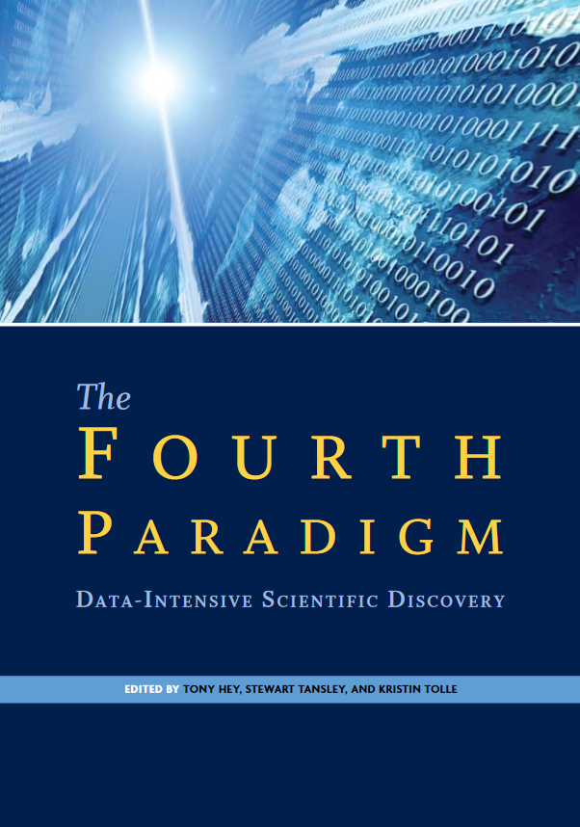
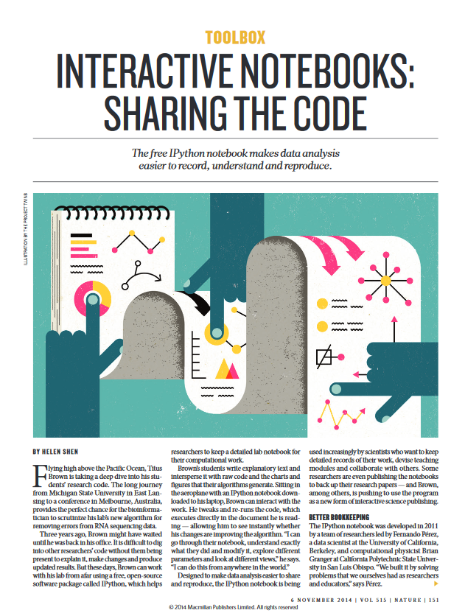
Inspired by…
“For data analysis, one possibility is to move the data to you, but the other possibility is to move your query to the data… Often it turns out to be more efficient to move the questions than to move the data.”
-- Jim Gray
Helen Shen’s article for Nature - Interactive notebooks: Sharing the code – featured a live demo of IPython notebooks created on-demand using Docker containers, and made a strong case for using IPython notebooks in scientific data analysis.

Slide 3
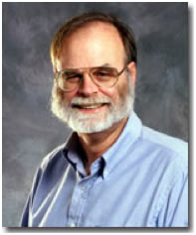
Motivation
Jim Gray: “Often it turns out to be more efficient to move the questions than the data.”

Slide 4
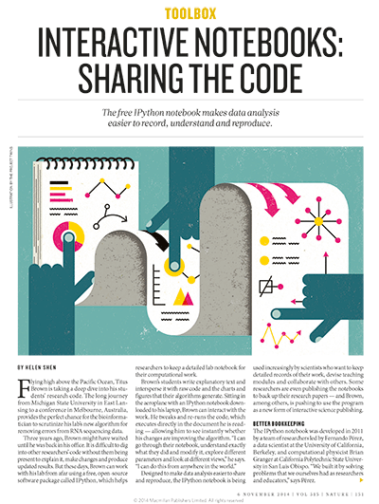
Motivation
Helen Shen: “Brown's students write explanatory text and intersperse it with raw code and the charts and figures... Sitting in the airplane… Brown can interact with the work..”

Slide 5
History
Started with the SDSS SkyServer (2001)
Goal: instant access to rich content
Idea: bring the analysis to the data
Interactive access at the core
Much of the scientific process is about data
Data collection, data cleaning, data archiving, data organization, data publishing, mirroring, data distribution, data analytics, data curation…
2012: NSF DIBBS to extend/reengineer SkyServer

Slide 6
What is SciServer Compute?
Interactive Jupyter notebooks hosted inside Docker containers.
Pre-configured images to create new containers from (R, Python, MATLAB, …).
High-bandwidth, low-latency access to other SciServer services and data sources through the notebooks.
Users manage their own containers.

Slide 7
Data in HPC Simulations
HPC is an instrument in its own right
Largest simulations approach/exceed petabytes
Need public access to the best and latest
Also need ensembles of simulations for UQ
Creates new challenges
How to access the data?
What is the data lifecycle?
What are the analysis patterns?
What architectures can support these?
On Exascale everything is a Big Data problem

Slide 8
What are Docker Containers?

Slide 9
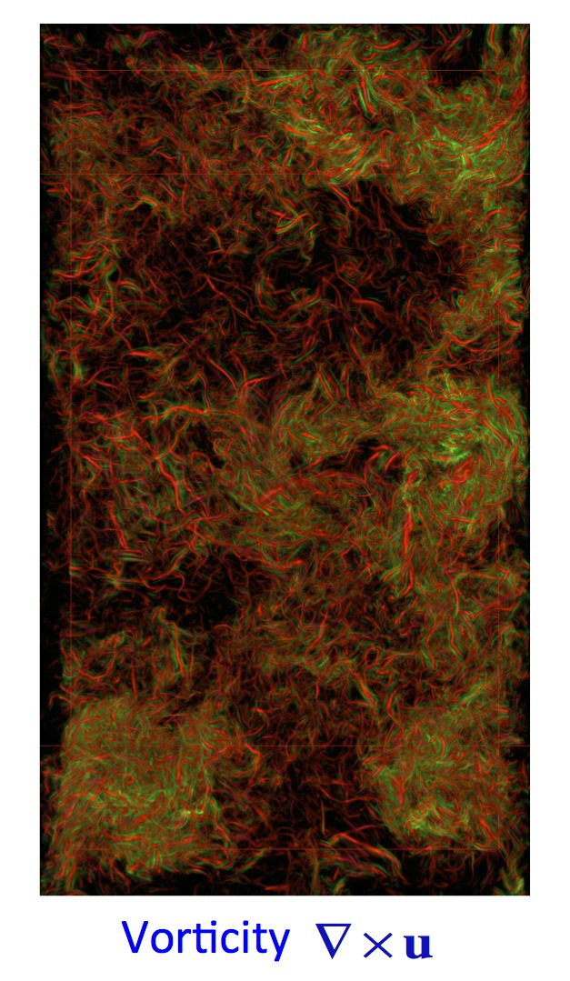
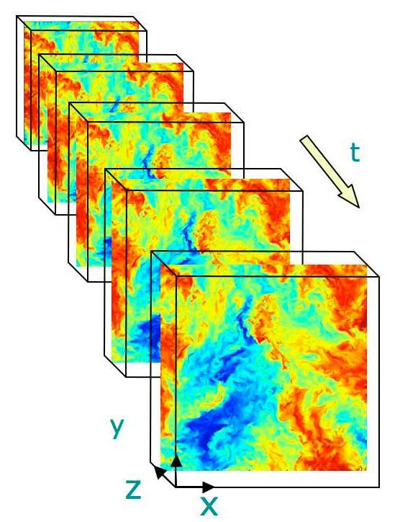
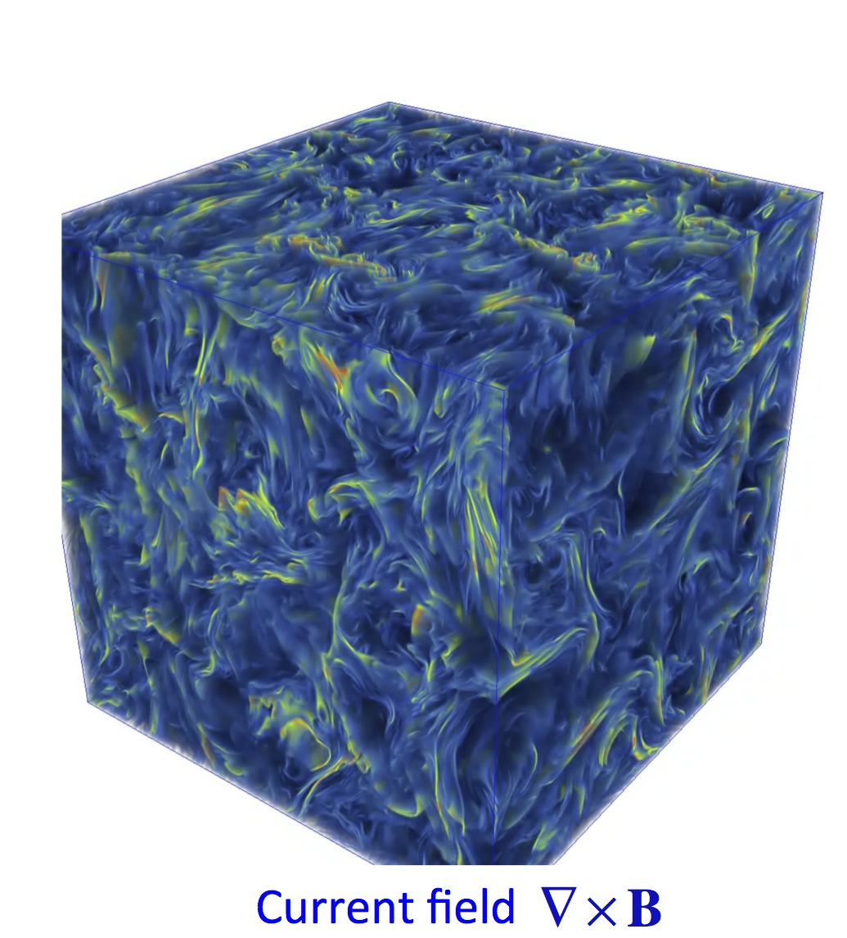
Turbulence databases (JHUTB)
http://turbulence.pha.jhu.edu/

Slide 10
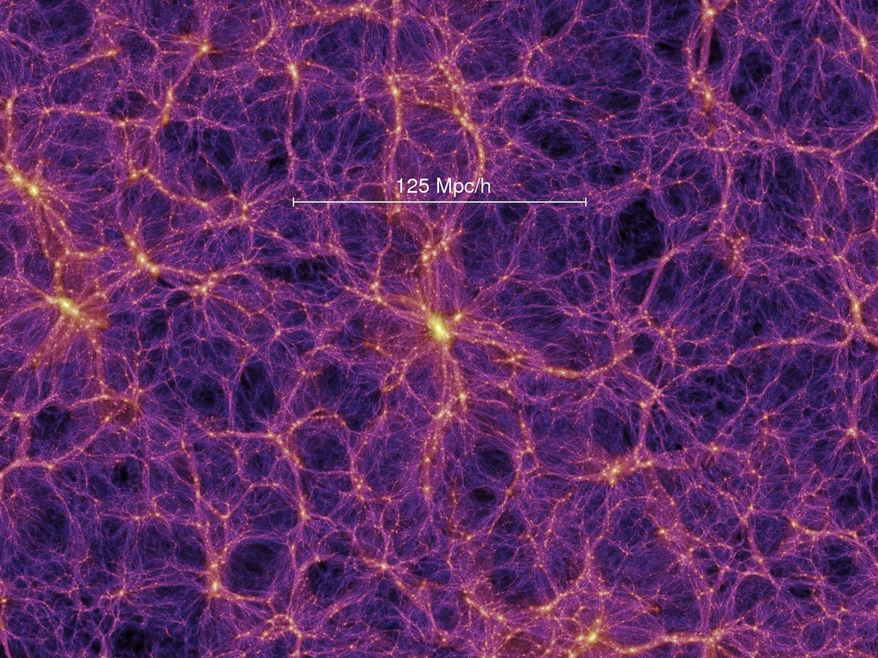
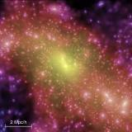
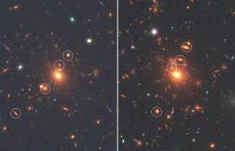
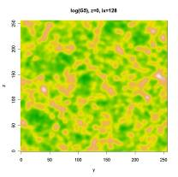
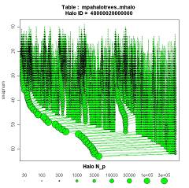
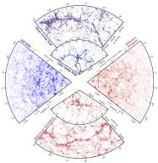
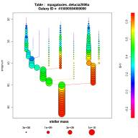
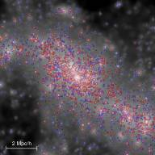
Cosmological Simulations
Mirror of Millennium Database
Raw data:
Particles
FOF groups
Subhalos
Mock images
Halo merger trees
Density fields
Synthetic galaxies
Mock catalogues

Slide 11
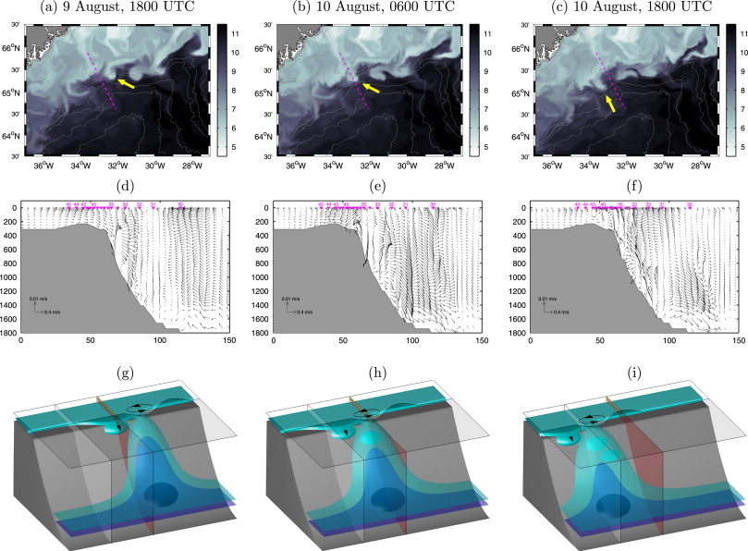
Oceanography
Hydrostatic and non-hydrostatic simulations of dense waters cascading off a shelf: The East Greenland case Marcello G. Magaldi, Thomas W.N. Haine

Slide 12
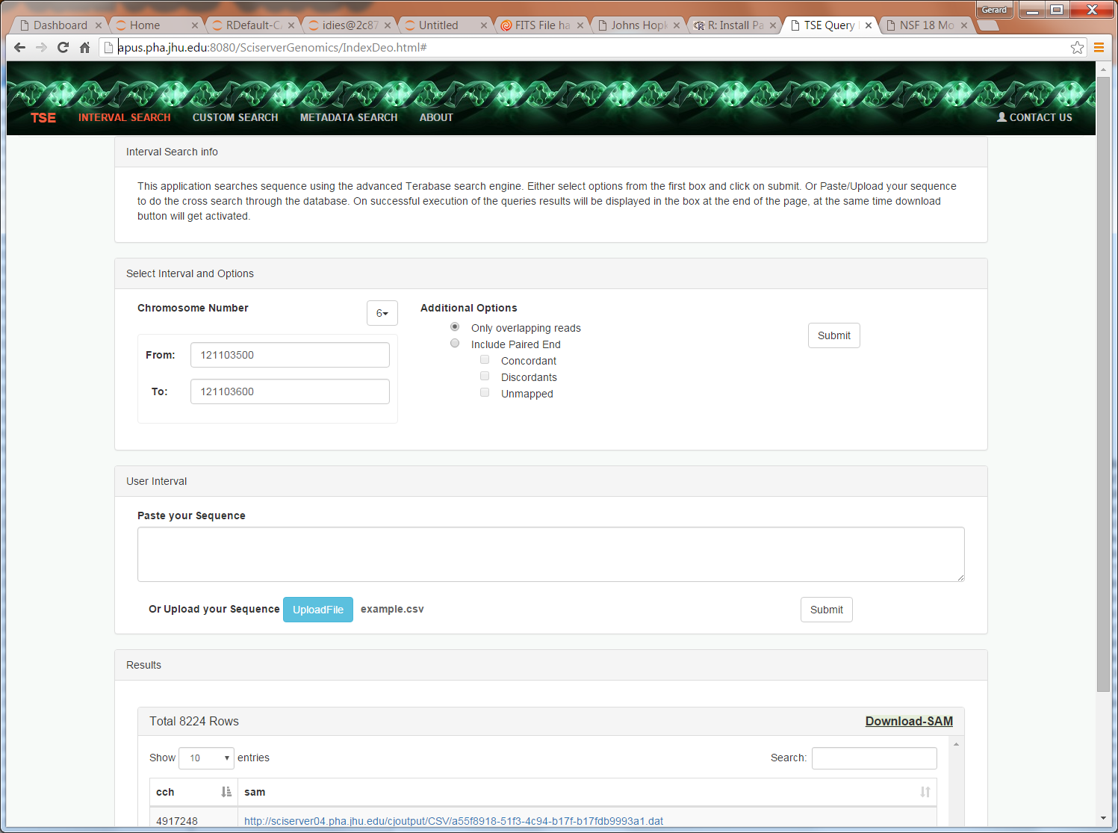
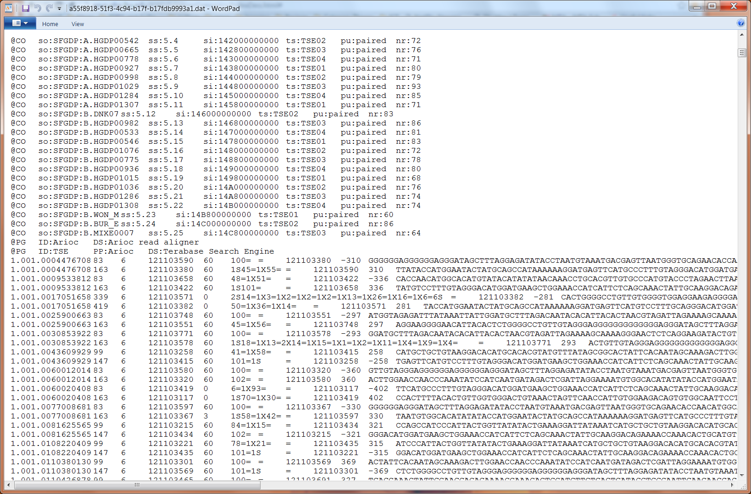
Genomics
Building a DB of a trillion short reads from Next Gen Sequencing

Slide 14
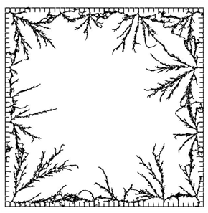
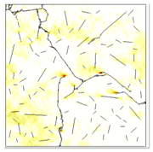
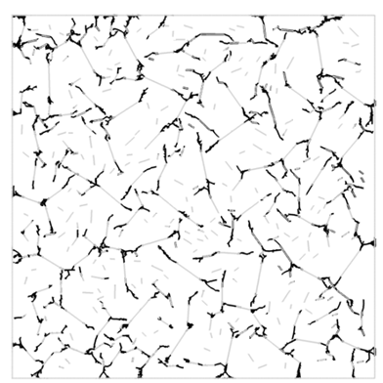
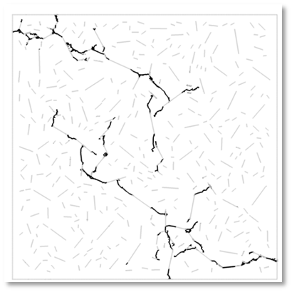
Materials Science
Daphalapurkar, Brady, Ramesh, Molinari. JMPS (2011)

Slide 15
Open Numerical Laboratories
Create interactive Numerical Laboratories
Analysis server-side through web service
Use virtual sensor metaphor
Many access patterns are local
No need to download whole data sets
Concept very successful in turbulence and cosmological N-body
turbulence.pha.jhu.edu: 19 trillion points delivered!
Total science data in SciServer currently ~2.5PB

Slide 16
Architectural Challenges
Need to define sharp tradeoffs
Data Analytics system is different from supercomputer
What is the right balance between I/O and compute?
Need high bandwidth to large data
Computations/visualizations must be on top of the data
Must support at least few 100TB per server
Petascale: 3 copies for production (or erasure code?)
Wide area data movement/backbone is hard
Lessons from the database world:
It is nontrivial to schedule complex I/O patterns
For subsets we must use indexing, cache resilient storage

Slide 17
SciServer Project Objectives
Objectives
Extend infrastructure for SDSS to support additional Science Domains
Host and serve petabyte datasets
Support custom user datasets
Provide access and query services
Provide scalable compute services
Support analyses and data sets too large to handle locally
Provide collaborative tools for shared analysis
Computations stay CLOSE to the DATA…

Slide 18
SciServer Project Components
Major Components | Supporting Technologies
Core | Microsoft SQL Server
Login Portal | Open Stack
CASJobs | Docker
SciServer Compute | Jupyter
SciDrive
Applications
SkyQuery
SkyServer
GLUSEEN
Turbulence

Slide 19
SciServer Project Timeline
Timelines
Year 1 (2013-2014) | Project Setup, Scoping, Planning, Begin Refactoring, SDSS Unification
Year 2 (2013-2014) | Architectural Refactoring – API, Single Sign-on, prototype Compute
Year 3 (2013-2014) | SciServer System Release, Interactive Compute, Scalable Job Management, Basic Dashboard, Initial Collaborative capabilities
Year 4 (2013-2014) | Implementation in Science Domains, Educational workbooks
Year 5 (2013-2014) | System Scale out, Data Analytics, Advanced Deployment Scenarios
NOW

Slide 20
SciServer Project Current Plans
Timelines – Year 3
Apr 2016 | SciServer System Release
May 2016 | Interactive Compute SkyQuery Gluseen
August 2016 | Prototype Scalable Job Management Basic Dashboard Initial Collaborative capabilities
October 2016 | Scalable Job Management Turbulence Cosmology
November 2016 | Project 3 year Review

Slide 21
Work in Progress
Run asynchronous non-interactive jobs in separate Docker containers. It’s meant to be more than just Jupyter notebooks!
Create new VM nodes on-demand to accommodate growing number of users.
Provide scratch (temporary) storage space for working with large amounts of data.
Improve resource management.

Slide 22
Data Storage Configuration

Slide 23
Questions?

Slide 24
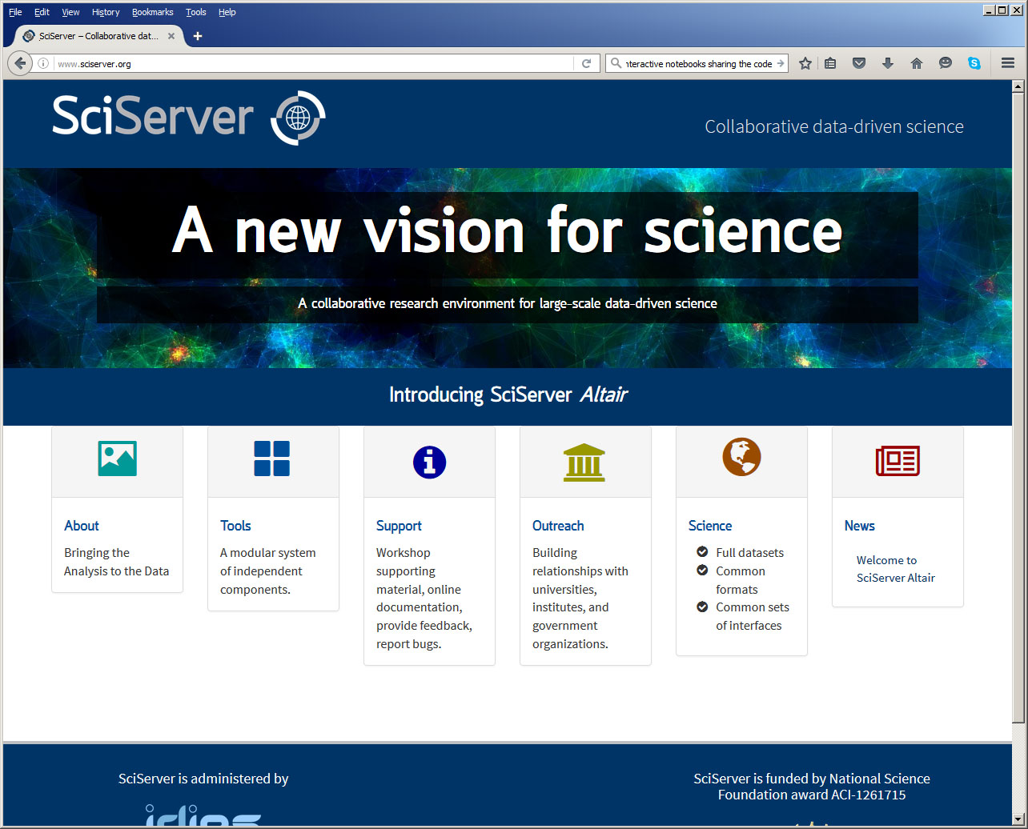
Login Portal

Slide 25
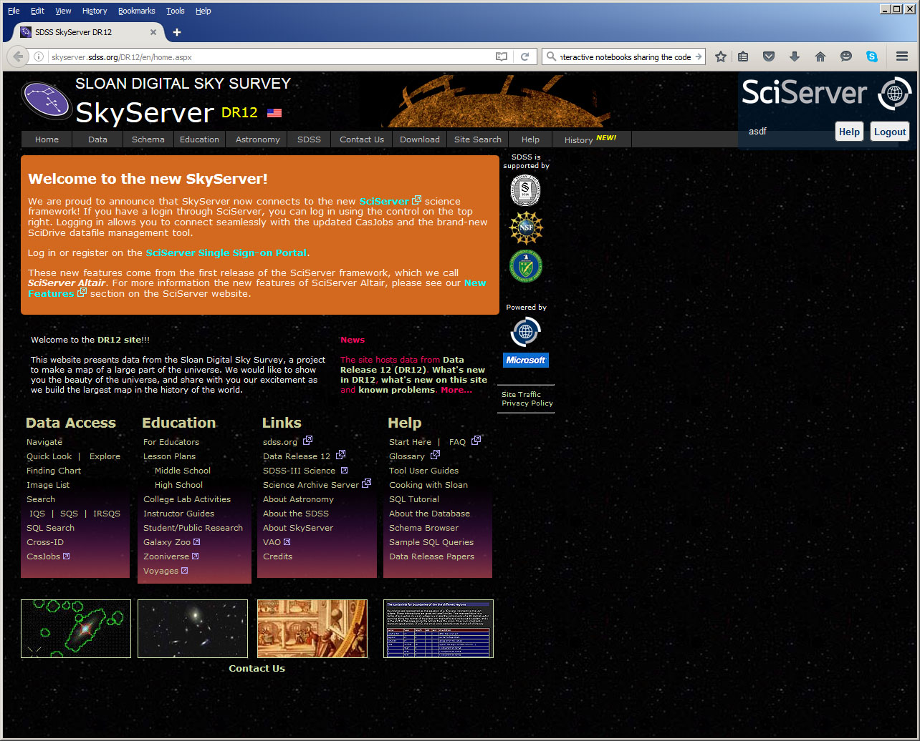
SkyServer

Slide 26
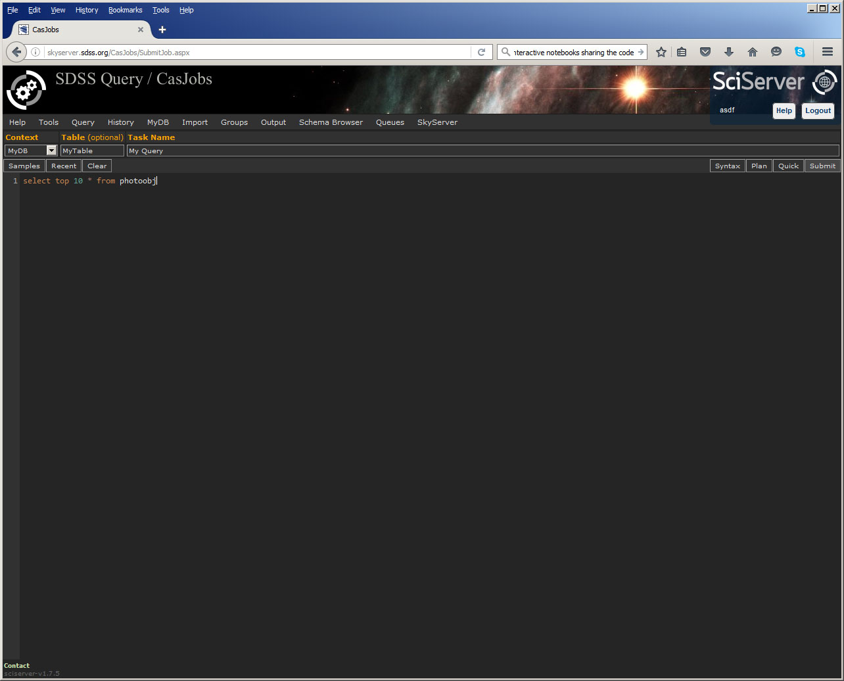
CasJobs: Query

Slide 27
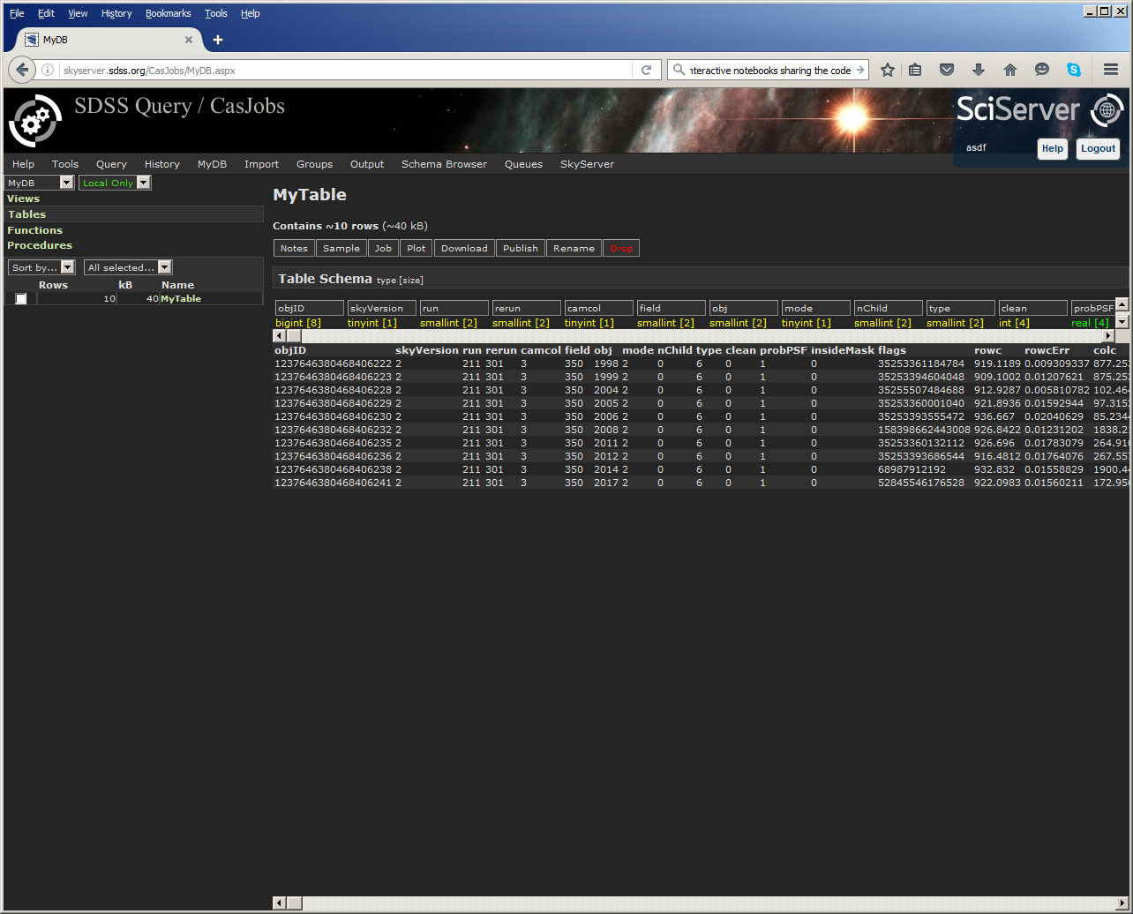
CasJobs: MyDB

Slide 28
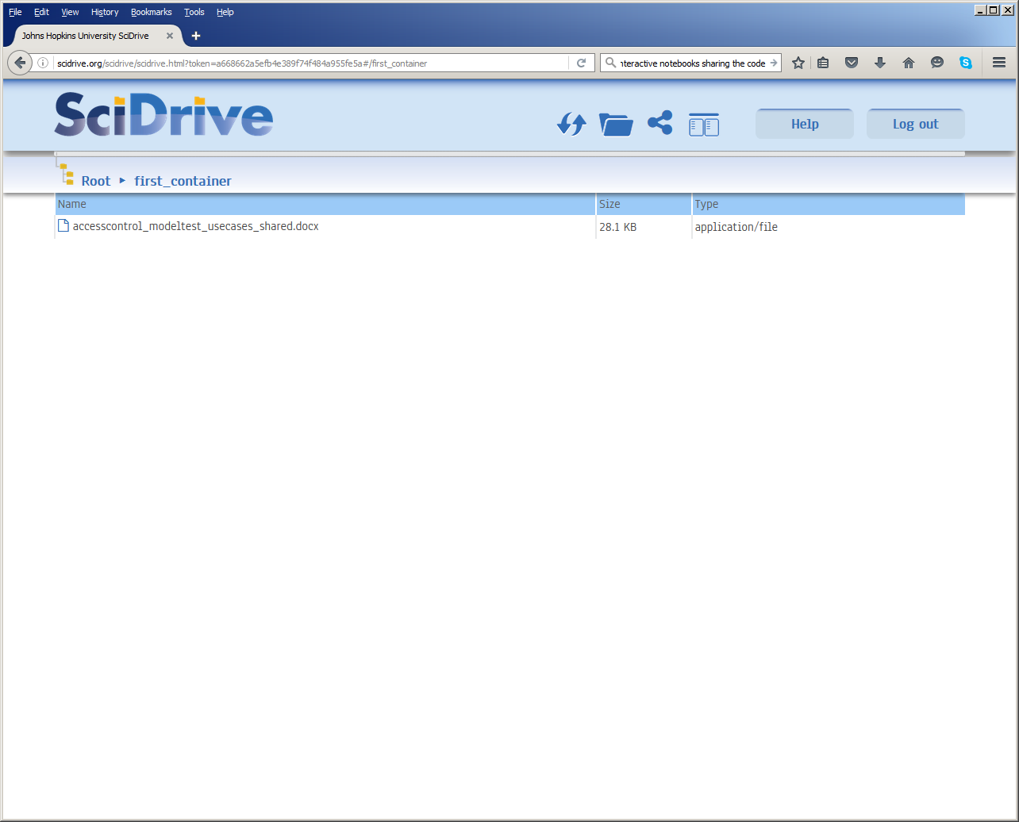
SciDrive

